Slide 1
HOT TOPICS
Lori Levy
General Counsel

Slide 2
Business Entities

Slide 3
Business Entity Choices
Sole proprietorship
Partnership
Corporation
Limited liability company (LLC)
              Formation
              Taxation
              Liability
              Succession

Slide 4
Sole Proprietorship
If you start a business by yourself and do not incorporate
No documents to file (automatic if no entity formed)
Sole proprietorships don’t pay taxes or file tax returns (you do)
You are personally liable for all debts and other liabilities
    Business creditor can go after personal assets
    Personal creditor can go after business assets

Slide 5
General Partnership
Two or more people contribute money, property and services, and in return receive a share of the earned profits
No documents to file (automatic if no entity formed)
legal existence distinct from its owners
“pass-through” entity for tax purposes
Partners are personally liable for all partnership debts and lawsuits
TREC: designated broker must be a manager or managing member

Slide 6
Corporations
Separate legal entity -- can hold title to property, sue and be sued, have bank accounts
Must file paperwork with the state -- needs a name, corporate bylaws, corporate records, and capitalization
Taxation: S corp v. C corp
Limitation on personal liability
TREC: designated broker must be a corporate officer

Slide 7
Limited Liability Company (LLC)
Hybrid: a cross between a partnership and corporation
Taxation:
      LLCs owned by two or more people are ordinarily taxed the same as partnerships.
      LLCs with only one owner, are taxed like sole proprietorships.
Provides owners the same limitation on liability as corporations for business debts and lawsuits
TREC: broker must be a manager or a managing member

Slide 8
Business Entity Misconceptions - TREC
A business entity is a type of business structure, such as a sole proprietorship, limited liability company (LLC), and partnership. A business entity may be licensed as a real estate broker.
v.
A DBA is the name a company uses in business that is not the legal name of the company.
Sales agent business entity
Use of term REALTOR in name

Slide 9
TREC Requirements
Be authorized to transact business in Texas
Designate an active Texas real estate broker to act on behalf of the organization
A current Franchise Tax Account Status page (issued within 21 days prior to the date of application) must be provided as evidence of being qualified to transact business in Texas. This status page is available from the TEXAS COMPTROLLER OF PUBLIC ACCOUNTS.
Proof of the designated broker's status as a managing officer, manager or managing member, or general partner for the business entity.
If the designated broker does not own at least 10% of the business entity, proof of E&O insurance for the entity must be provided.
If the designated broker owns 10% or more of the business entity, proof of ownership must be provided.

Slide 10
Succession Planning
Individual Broker License
Business Entity Broker License

Slide 11
Americans with Disability Act
Website accessibility

Slide 12
Website Accessibility
ADA -- a federal law that prohibits discrimination against people with disabilities and ensures equal access and services to those individuals.
Public accommodation = facilities used by the public; affect commerce
The DOJ has held that if your business fits in the definition of public accommodation, the law may apply to your website.
Courts split
Web Content Accessibility Guidelines (WCAG).

Slide 13
Brokerage Insurance

Slide 14
E&O Claims
Failure to Disclose/Misrepresentation
Agent-Owned Properties/Flipping
Property Management
Automobile accidents

Slide 15
Hired and Non-Owned Auto Insurance
Non-owned coverage applies to employees’ and agents’ vehicles when being used on behalf of the real estate brokerage
Can be added to a general liability policy
Check driving records?
Ask your insurer!

Slide 16
TREC Update
Forms Changes

Slide 17
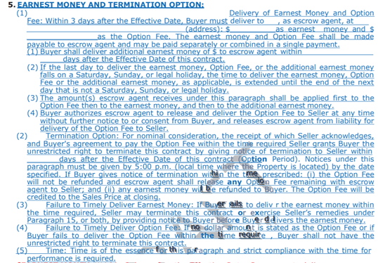
https://www.texasrealestate.com/members/legal-and-ethics/forms/form-changes/proposed-revisions/

Slide 18
Questions
Still have questions? Call the Legal Hotline (800) 873-9155

